Slide 1
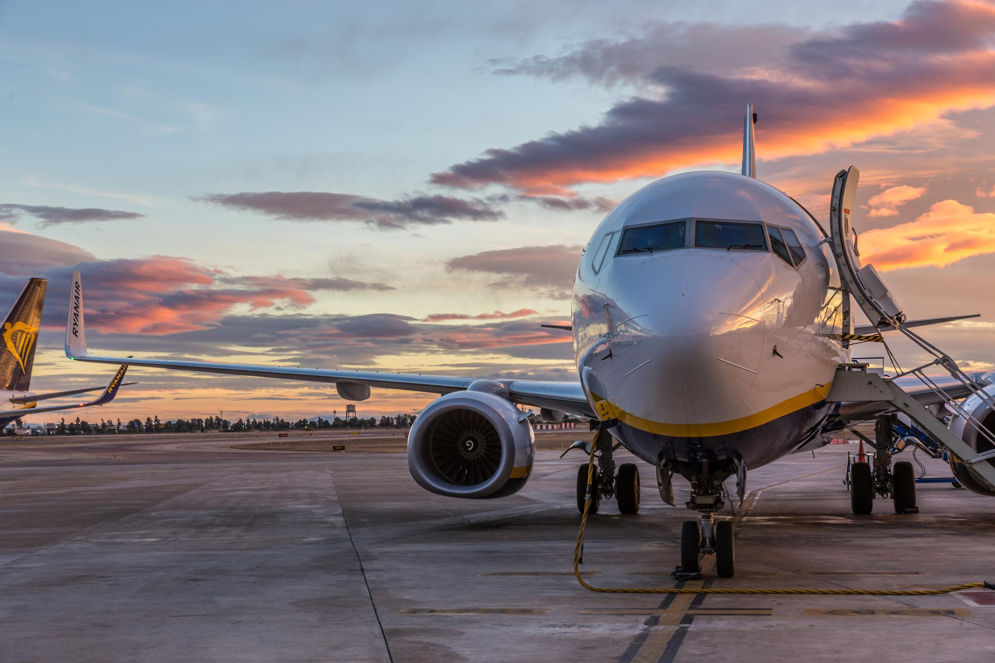



Unveiling Flight Disruptions Insights
Group BA7
Jinke Han, Sneha Sunil Ekka, Tanvi Sheth, Mingze Wu, YuChun Su

Slide 2
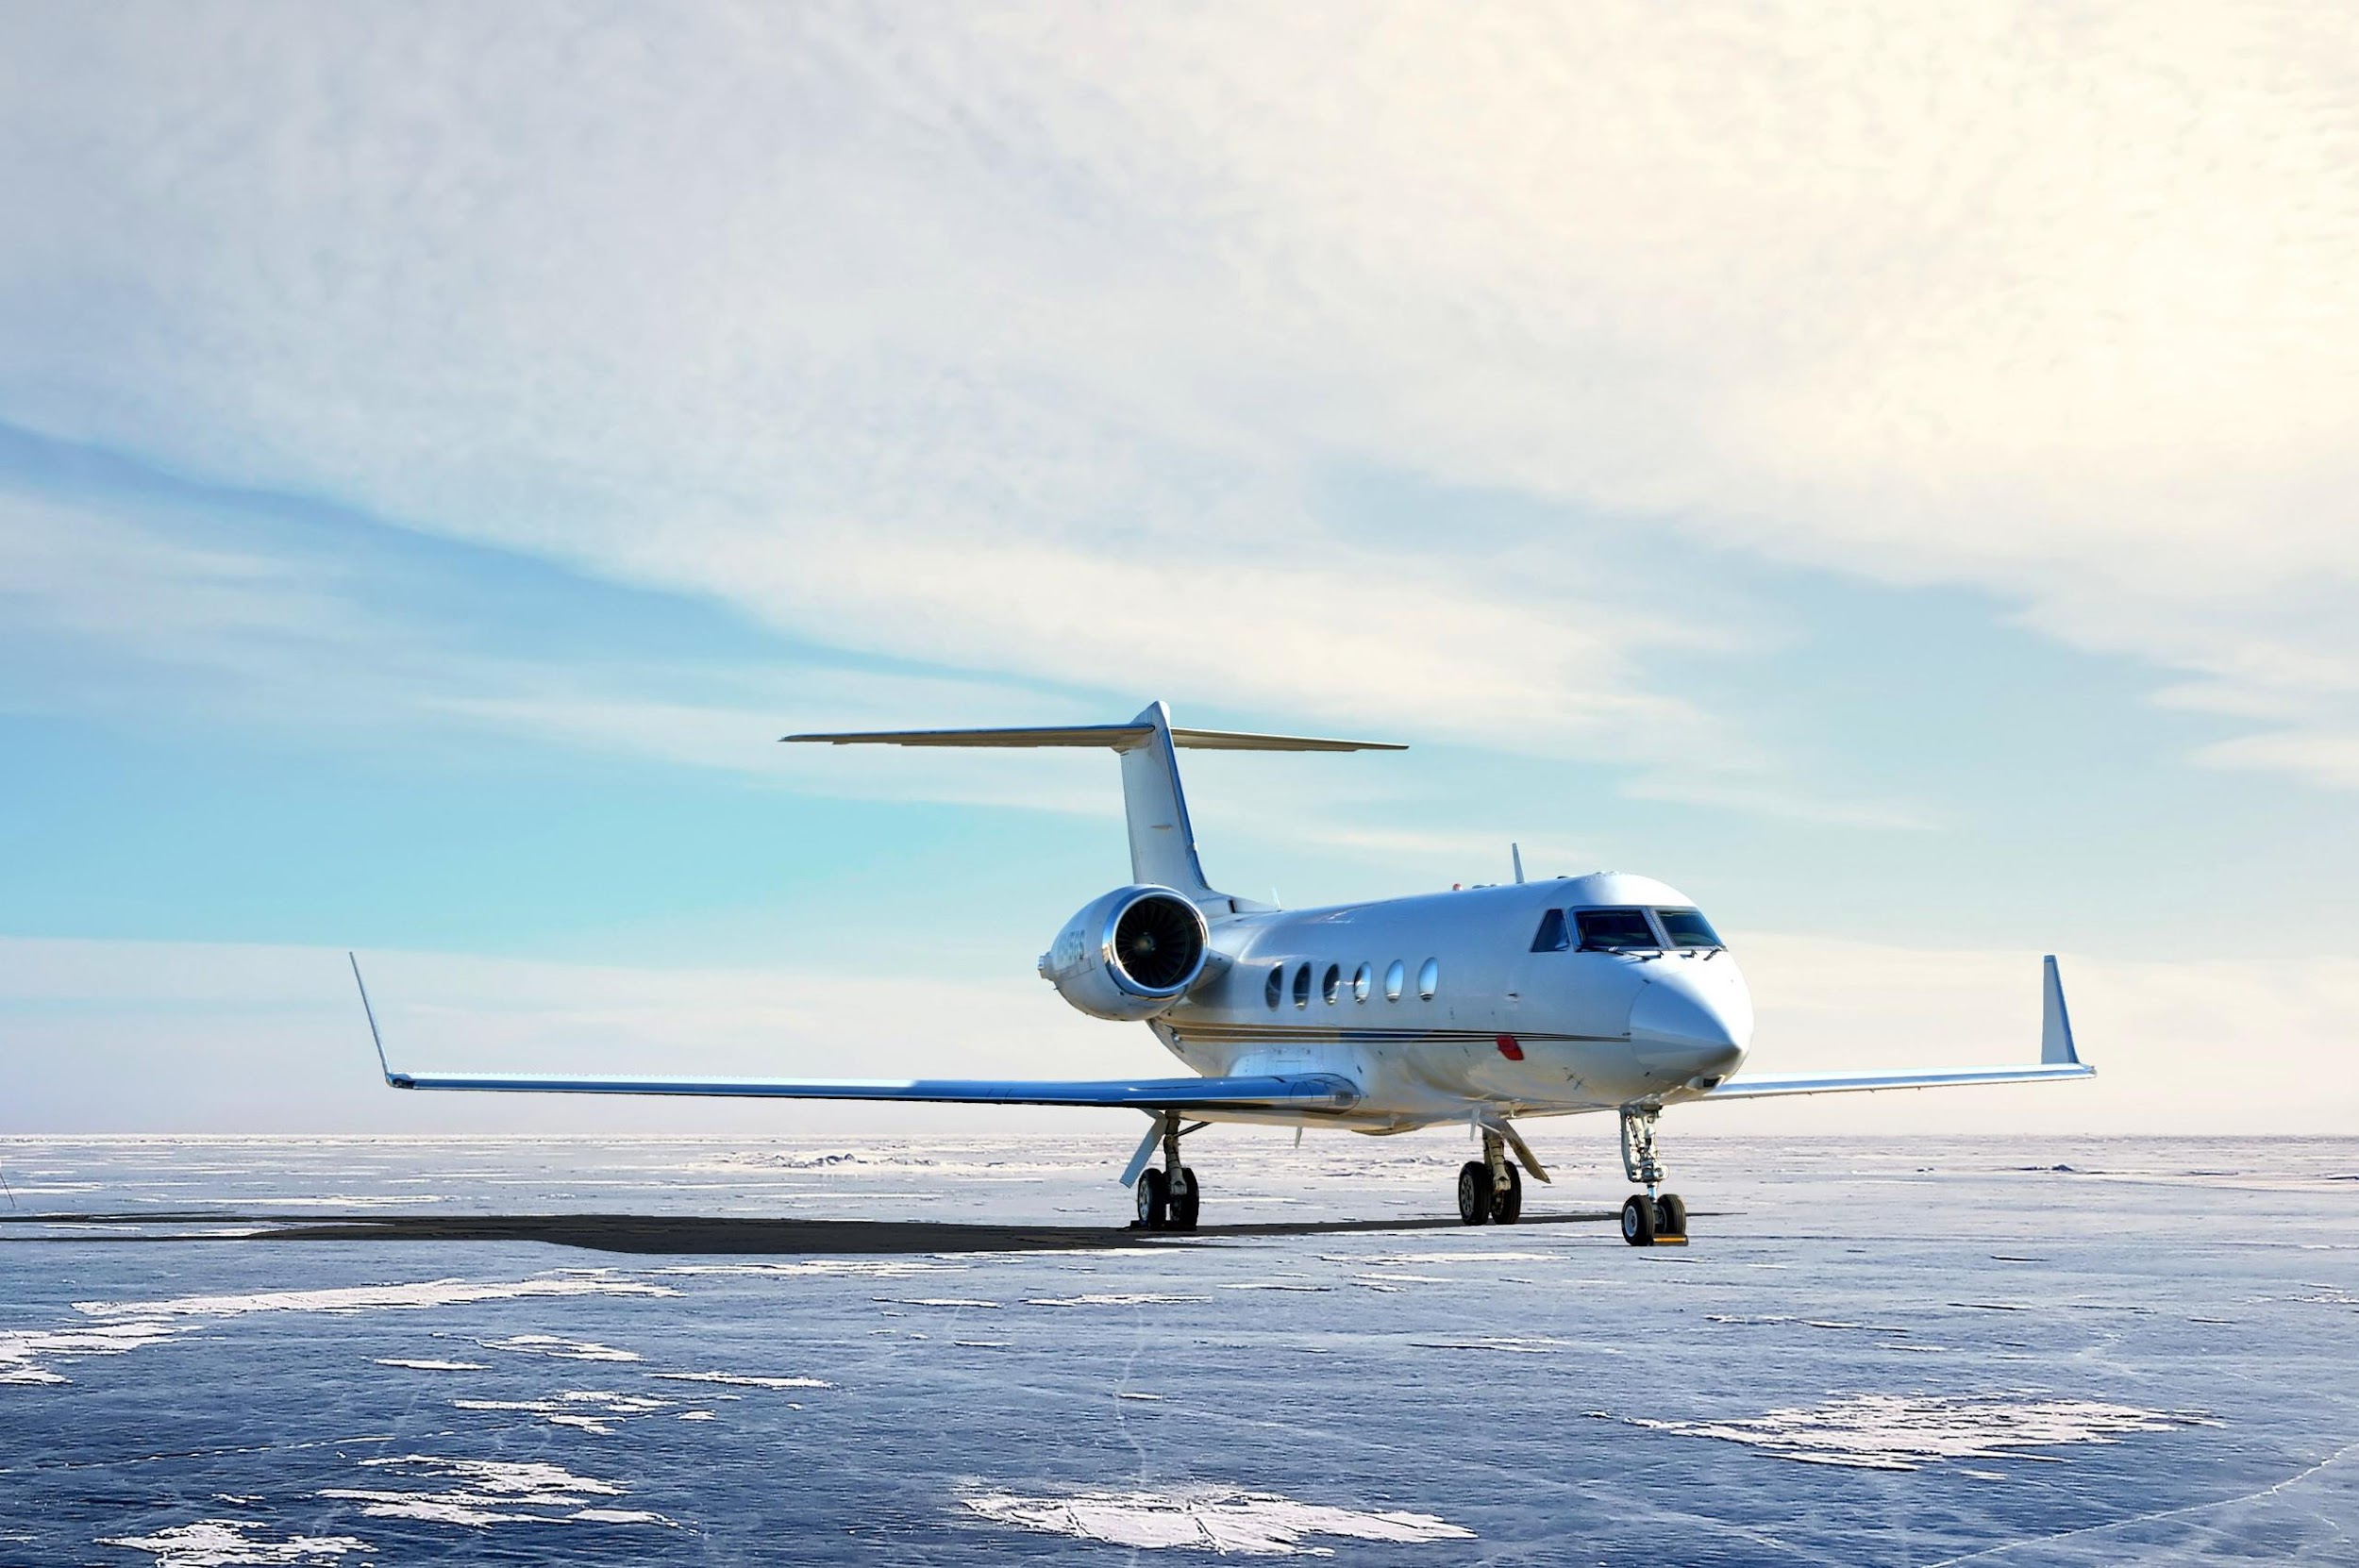
Outline
Motivation
Business Description
Dataset Introduction
Exploratory Data Analysis
Location aspect
Airline aspect
Time aspect
Machine Learning Classification
Challenges
Conclusion

Slide 3
Motivation
Problem
Flight delays and cancellations are inconvenient, disruptive, stressful, and costly
Goal
Identify unique patterns among airlines and airports to enhance operational efficiency, improve travel experiences, and mitigate economic losses
Notes:
Many of us have likely encountered flight delays and cancellations, which are not only inconvenient and disruptive but also stressful and costly, often disrupting our original plans. Flight delays are more than just inconveniences; they disrupt plans, cause stress, and incur economic losses. Our project is driven by a shared empathy for the frustrations passengers face and a commitment to alleviating them. By analyzing data on flight delays and cancellations, we aim to uncover patterns unique to airlines and airports, ultimately enhancing operational efficiency and improving the overall travel experience. Our goal is not only to minimize disruptions but also to offer proactive solutions that mitigate their economic impact, ensuring smoother journeys for all travelers.

Slide 4
Business Description
In-depth analysis of delays over time to identify seasonal trends and variations, providing valuable insights into factors influencing flight schedules
Develop predictive models to estimate delay durations, empowering stakeholders with proactive risk mitigation strategies
Provide passengers with optimal travel time recommendations, enabling informed decisions to minimize disruption impacts on their plans
Notes:
we aim to provide valuable insights and recommendations that benefit both airlines and passengers, ultimately contributing to smoother and more reliable air travel experiences.
in-depth analysis of delays over time to uncover recurring trends and seasonal variations, providing valuable insights into the factors influencing flight schedules and punctuality
develop predictive models capable of estimating the approximate duration of delays to provide stakeholders with actionable insights for proactive planning and risk mitigation strategies. to offer passengers optimal travel time recommendations based on our analysis, enabling them to make informed decisions and minimize the impact of disruptions on their travel plans.

Slide 5

Dataset
5 years of flight data from 2018 to 2022 for US commercial airlines
detailed information about the flight status with respect to the cancellations and delays
total 61 columns including flight dates, airline information, aircraft information, departure and arrival times

Slide 6
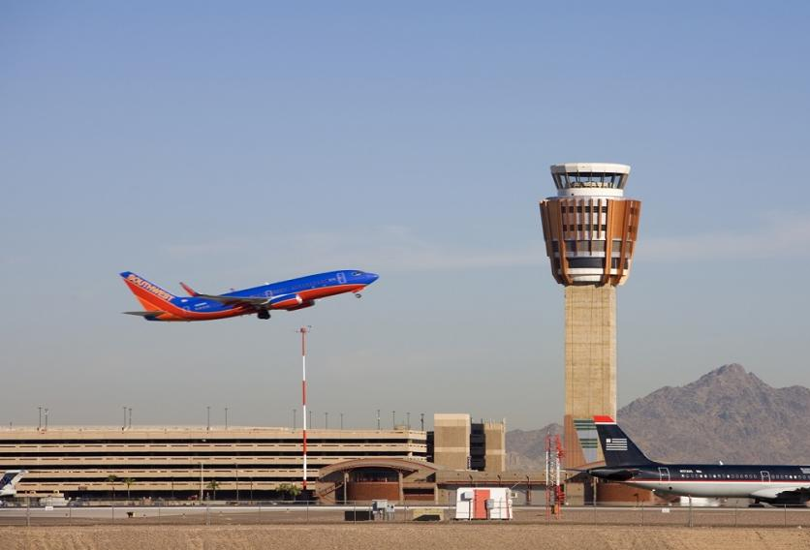
Exploratory Data Analysis
Location

Slide 7
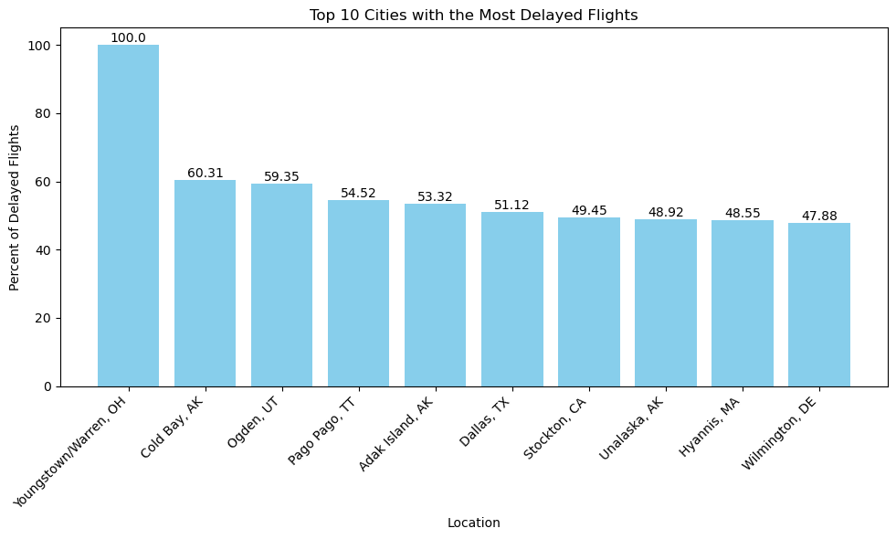
Which cities experienced the highest percentage of delayed flights?
Top 10 Cities with the Most Delayed Flights
+-----------------------------------+------------+--------------------+-----------------------+
| OriginCityName | Count | Delayed Count | Delay Proportion|
+-----------------------------------+------------+--------------------+-----------------------+
| Youngstown/Warren, OH | 2 | 2 | 100.00%|
| Cold Bay, AK| 262 | 158 | 60.31%|
| Ogden, UT| 460 | 273 | 59.35%|
| Pago Pago, TT| 299 | 163 | 54.52%|
| Adak Island, AK| 452 | 241 | 53.32%|
| Dallas, TX| 292,538 | 149,560 | 51.12%|
| Stockton, CA| 3,521 | 1,741 | 49.45%|
| Unalaska, AK| 1,392 | 681 | 48.92%|
| Hyannis, MA| 379 | 184 | 48.55%|
| Wilmington, DE| 165 | 79 | 47.88%|
+-----------------------------------+------------+--------------------+-----------------------+
Youngstown/Warren is very surprising as it shows that 100% of the flights from this city have been delayed. However, the total number of flights departed from this city in 5 years is only 2.
A lot of regional airports with comparatively lesser number of flights are more prone to delays rather than international airports, with the exception of Dallas, Texas.
Notes:
9/10/11

Slide 8
What happened in Dallas?
Dallas airports experience significant delays compared to other international airports.
The average delay at Dallas Fort-Worth is notably higher than at Dallas Love Field.
Regional airlines are responsible for the longest delays at both Dallas airports.
This data supports previous findings that international airlines generally operate more efficiently than regional ones.
+--------+---------------------------------+----------------+------------------+--------------------+
|Origin|Airline |Total_delay |Flight_count |Average_delay |
+--------+---------------------------------+----------------+------------------+--------------------+
|DAL |SkyWest Airlines Inc. |100,061.0 |2,286 |43.77 ｜
|DAL |Delta Air Lines Inc. |72,566.0 |1,830 |39.65 ｜
|DAL |Alaska Airlines Inc. |32,668.0 |850 |38.43 |
|DAL |Endeavor Air Inc. |787.0 |21 |37.48 |
|DAL |Virgin America |5,877.0 |196 |29.98 |
|DFW |GoJet Airlines, LLC |7,456.0 |80 |93.20 |
|DFW |Compass Airlines |27,630.0 |305 |90.59 |
|DFW |Endeavor Air Inc. |72,875.0 |1,074 |67.85 |
|DFW |Republic Airlines |103,899.0 |1,591 |65.30 |
|DFW |ExpressJet Airlines LLC |99,216.0 |1,556 |63.76 |
+---------+--------------------------------+------------------+----------------+---------------------+
Notes:
9/10/11

Slide 9
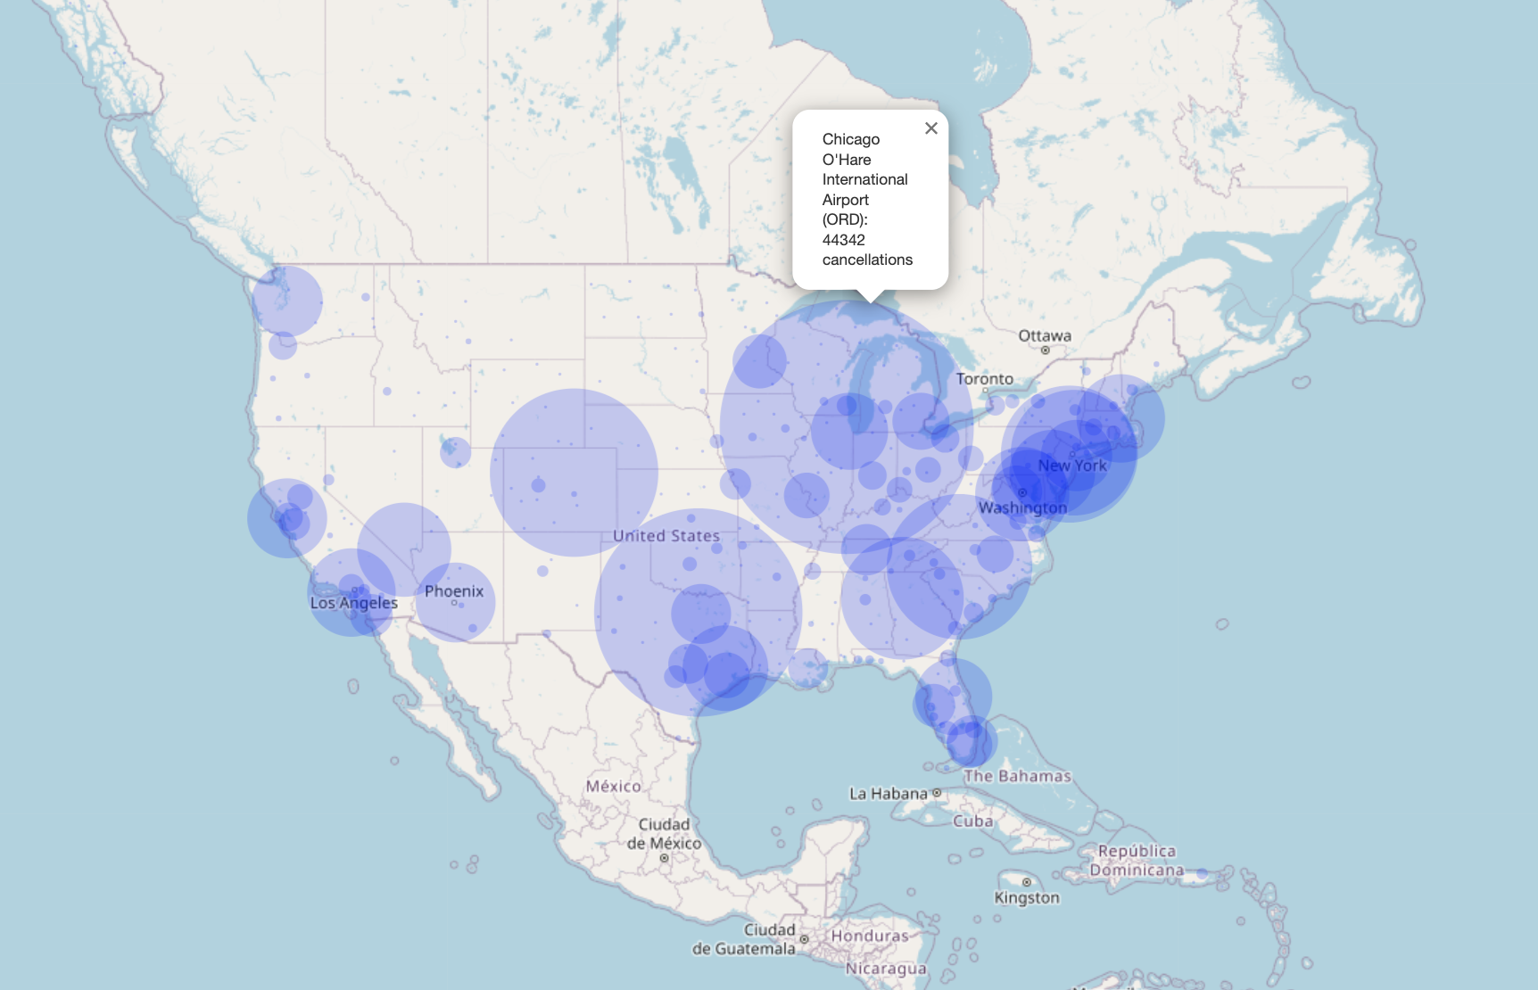
Which airport locations were most prone to cancellations?
Top 3 Airports with the Most Cancelled Flights
+-------------+----------------------+
| Origin | CancelledFlights|
+-------------+----------------------+
| ORD| 44342|
| DFW| 36698|
| DEN| 29676|
+-------------+----------------------+
The top three airports with the most cancellations are all situated in the central to eastern portions of the USA
Flight cancellations across the USA are unevenly distributed, with a higher concentration in the eastern regions
The western U.S., including airports like Los Angeles International (LAX), shows fewer cancellations compared to the east.
Notes:
9/10/11

Slide 10
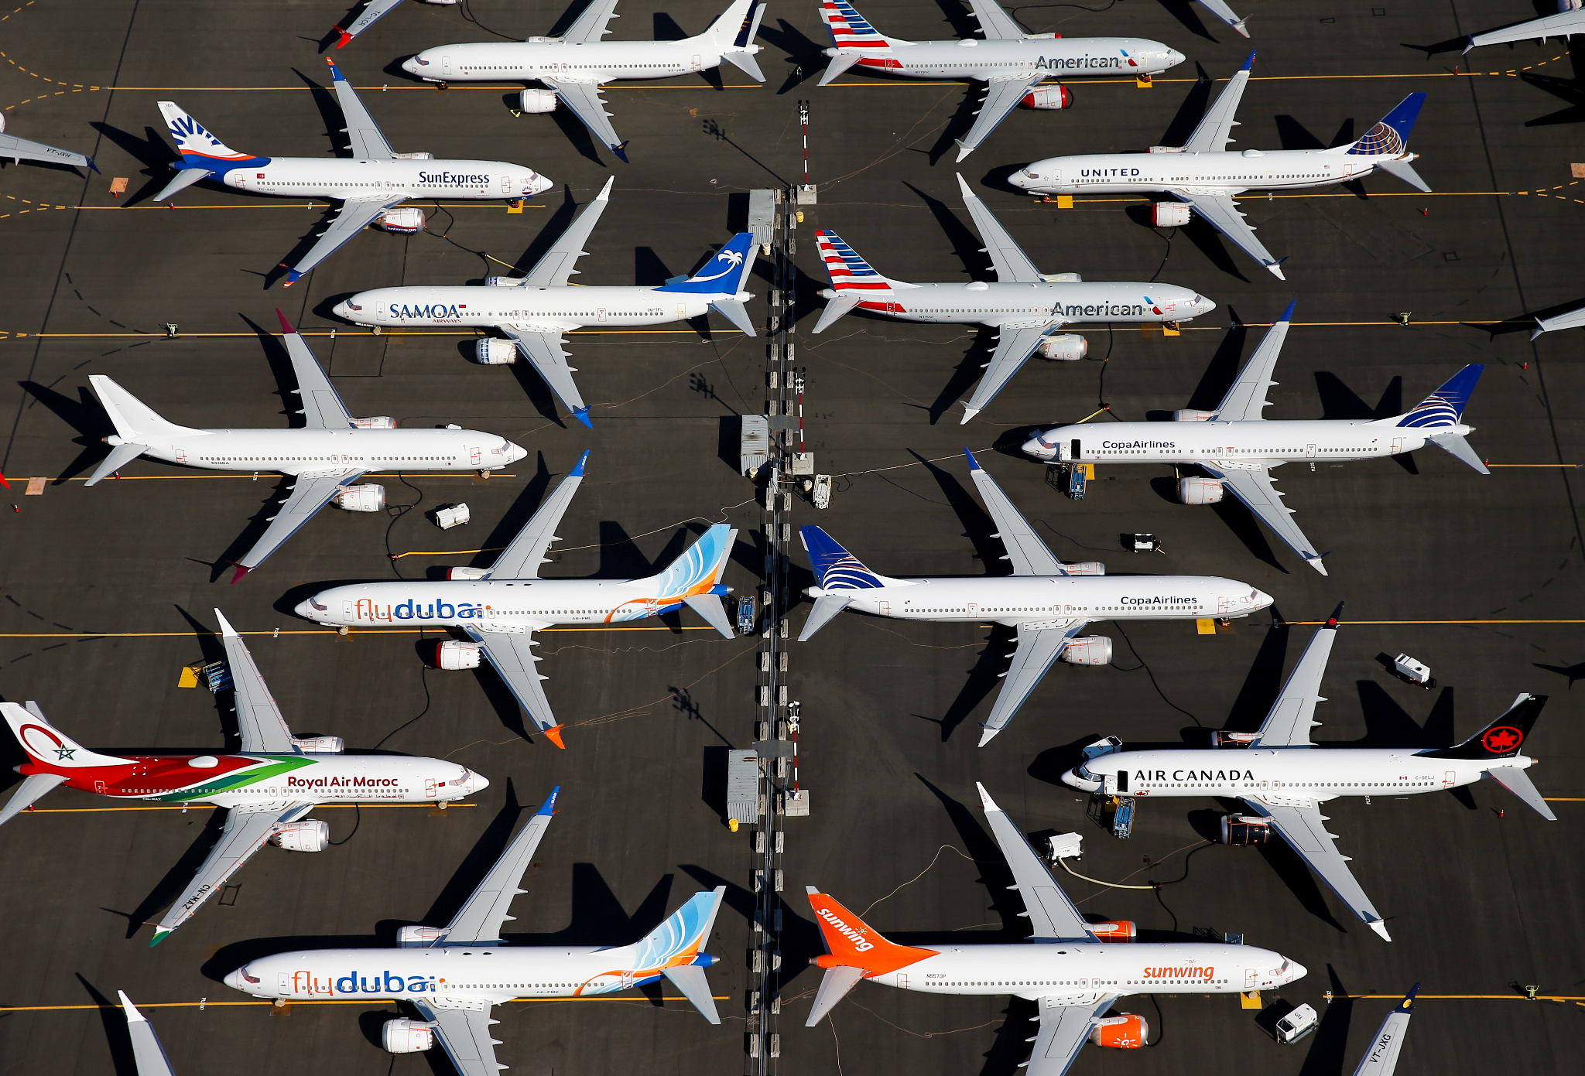
Exploratory Data Analysis
Airline

Slide 11
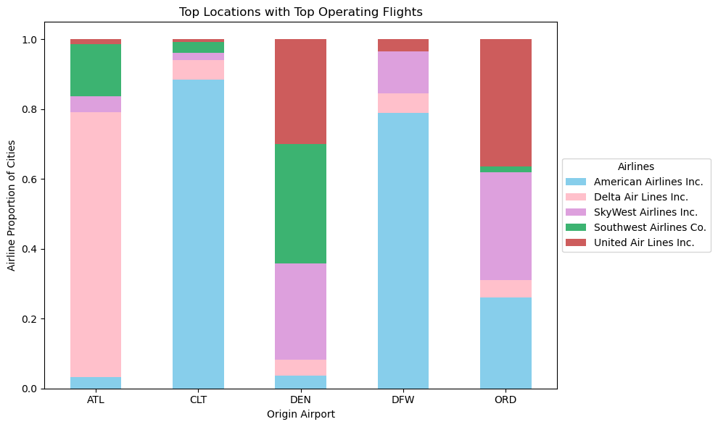
Proportion of airlines at the busiest airports
Top Locations with Top Operating Flights
The top airlines that fly the most are mainly international.
United Airlines is more common in northern cities like Chicago and Denver, while United and Delta Airlines are more popular in the south.
Notes:
14

Slide 12
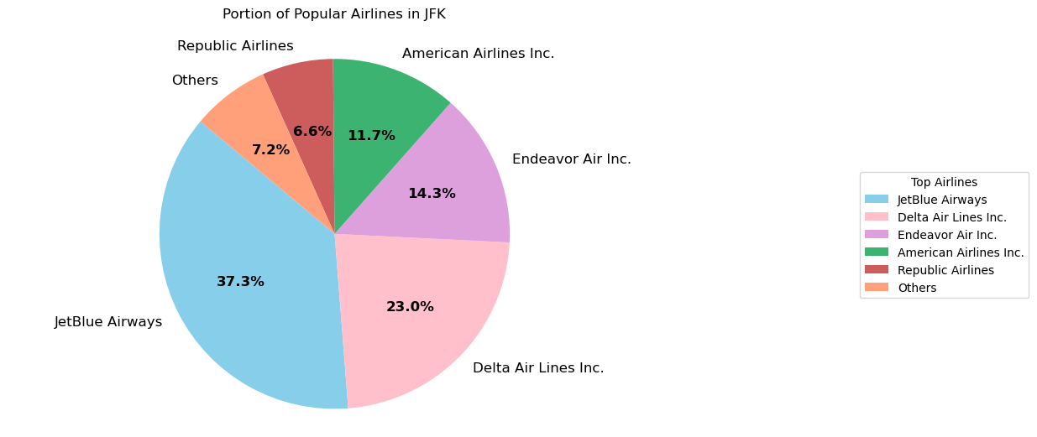
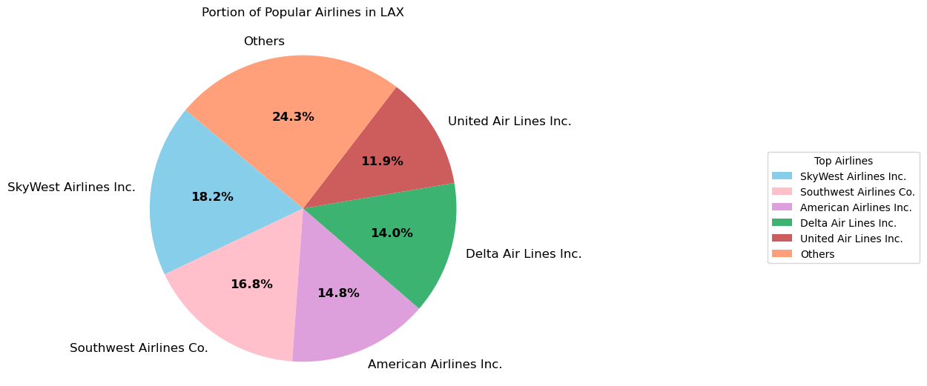
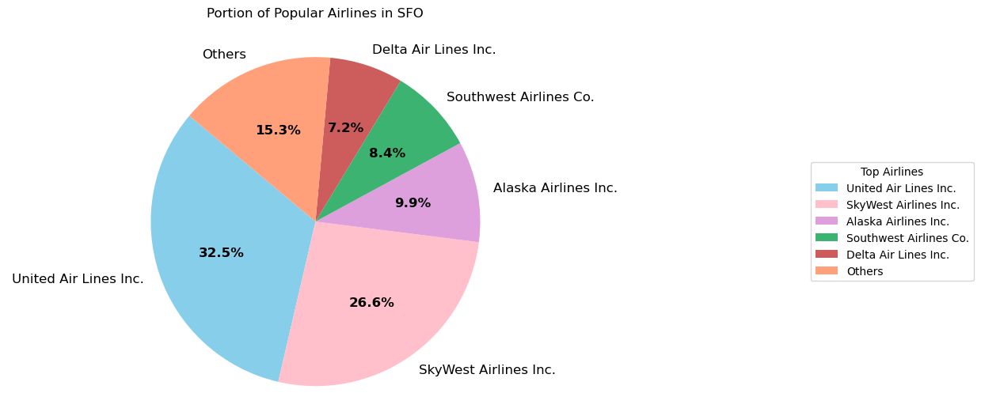
Proportion of Major Airlines at Three Popular International Airports
For JFK，JetBlue Airways and Delta Airlines handle more than half of all flights, making them the biggest players there.
For LAX, this airport has a mix of many airlines, with no single airline having more than 20% of the flights which means it serves a wide variety of airlines, including smaller regional ones.
For SFO, Similar to JFK, two airlines at San Francisco airport control nearly 60% of the flights, showing they have a major presence there.
Notes:
12

Slide 13
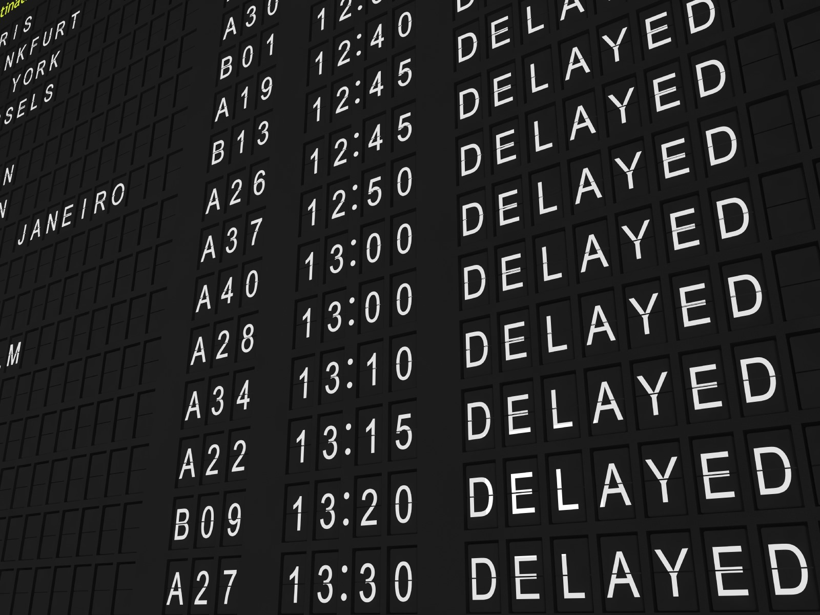
Exploratory Data Analysis
Time
Notes:
Mit - Q 9/10/11/12/14/15

Slide 14
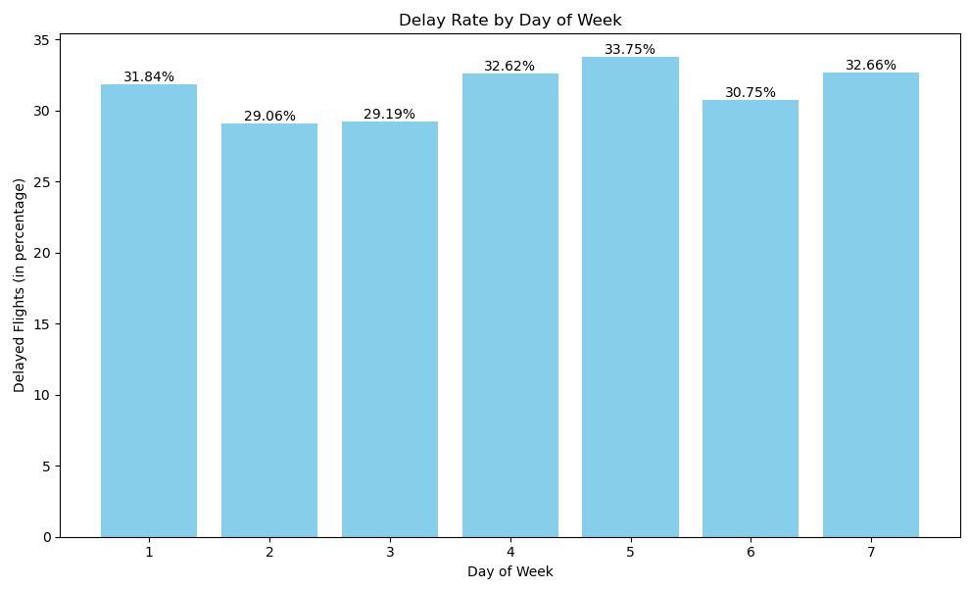
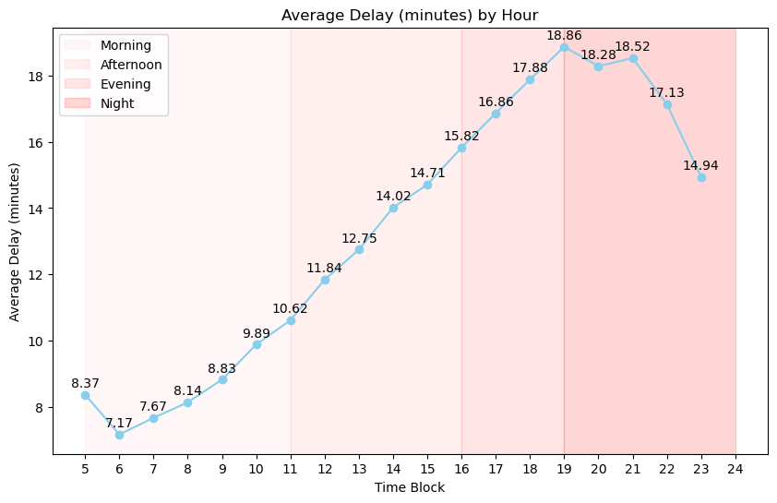
When do you expect more Delays?
By Date of Week
By Hour of Day
+-------------+------------------+----------------+-----------------------+
|DayType |total_delayed|total_flights |delay_proportion|
+-------------+------------------+----------------+-----------------------+
|Weekday | 6619206| 21216200| 31.20|
| Weekend| 2522642| 7976469| 31.63|
+-------------+------------------+----------------+-----------------------+
Delays time shows a rising trend throughout the day, peaking at about 19 minutes on average at around 7 PM, with evening and night periods experiencing the longest delays.
No distinguishable patterns by day of the week and by weekday/weekend.
Notes:
9/10/11

Slide 15
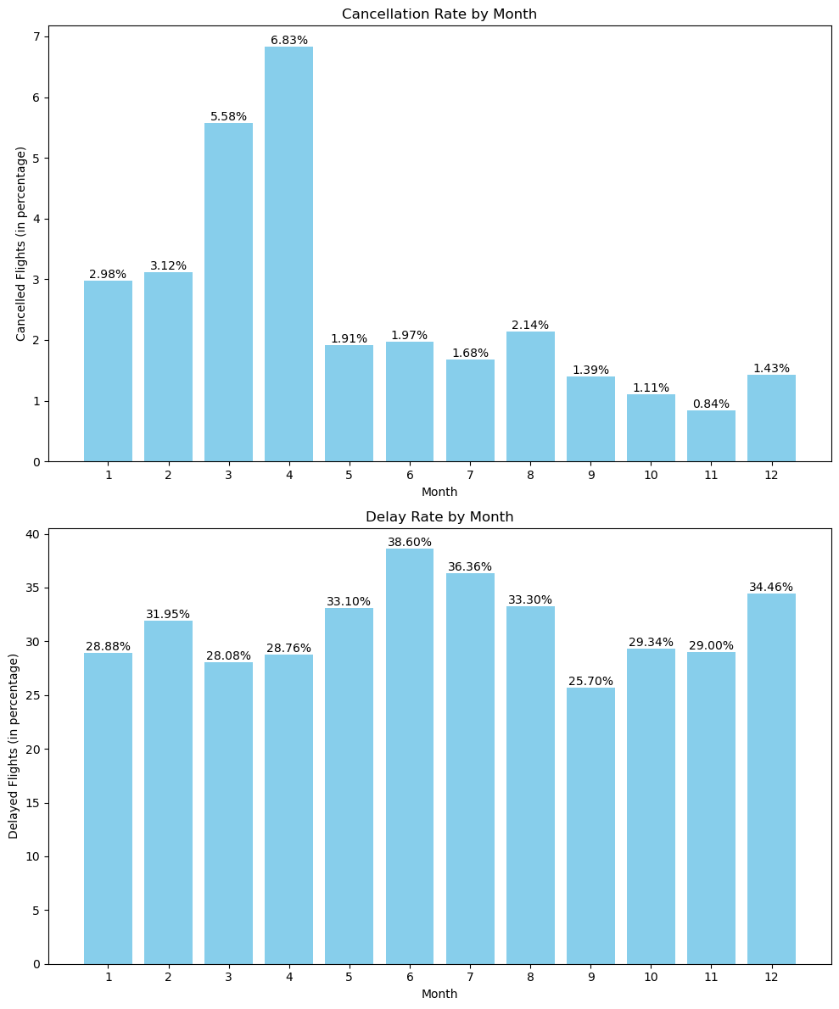
Cancellation and Delay patterns by Month
Delays
Cancellation
Flight delays by month do have seasonal pattern.
Higher delay rates occur during the summer months, which typically correspond to the summer travel season in many regions.
Highest cancellation rates occurring in the winter and early spring months
Cancellation rates shoot up in the months of March and April
Notes:
12

Slide 16
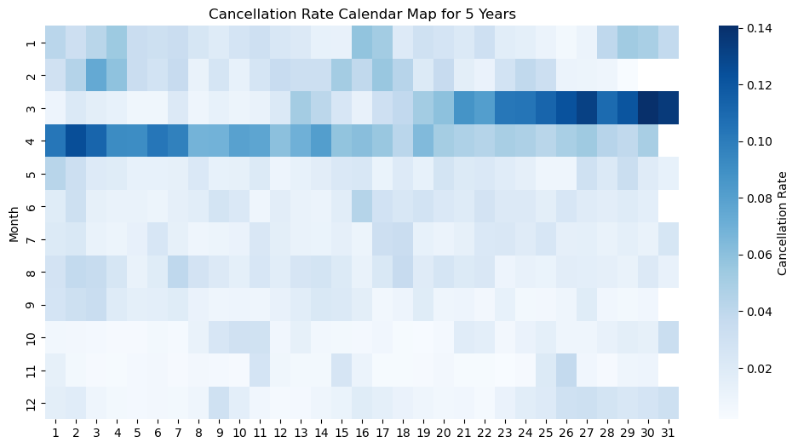

Average Daily Cancellation rates Over 5 Years
Average Cancellation %
We see a jump in cancellations by month
We dive deeper into understanding why that is.
March to April
Month
Day
Notes:
14

Slide 17
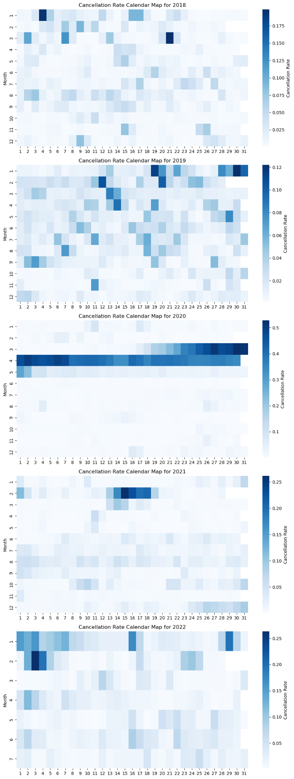

Average Daily Cancellation rates for Each Year
18 %
50 %
25 %
2018
2019
2020
2021
2022
12 %
25 %
Notes:
15 Turns out it is because of COVID.

Slide 18


ML
Classification
Presentations are tools that can be used as lectures, speeches, reports, and more. It is mostly presented like before an audience.
FLIGHT AS YOU GO
Presentations are tools that can be used as lectures, speeches,

Slide 19
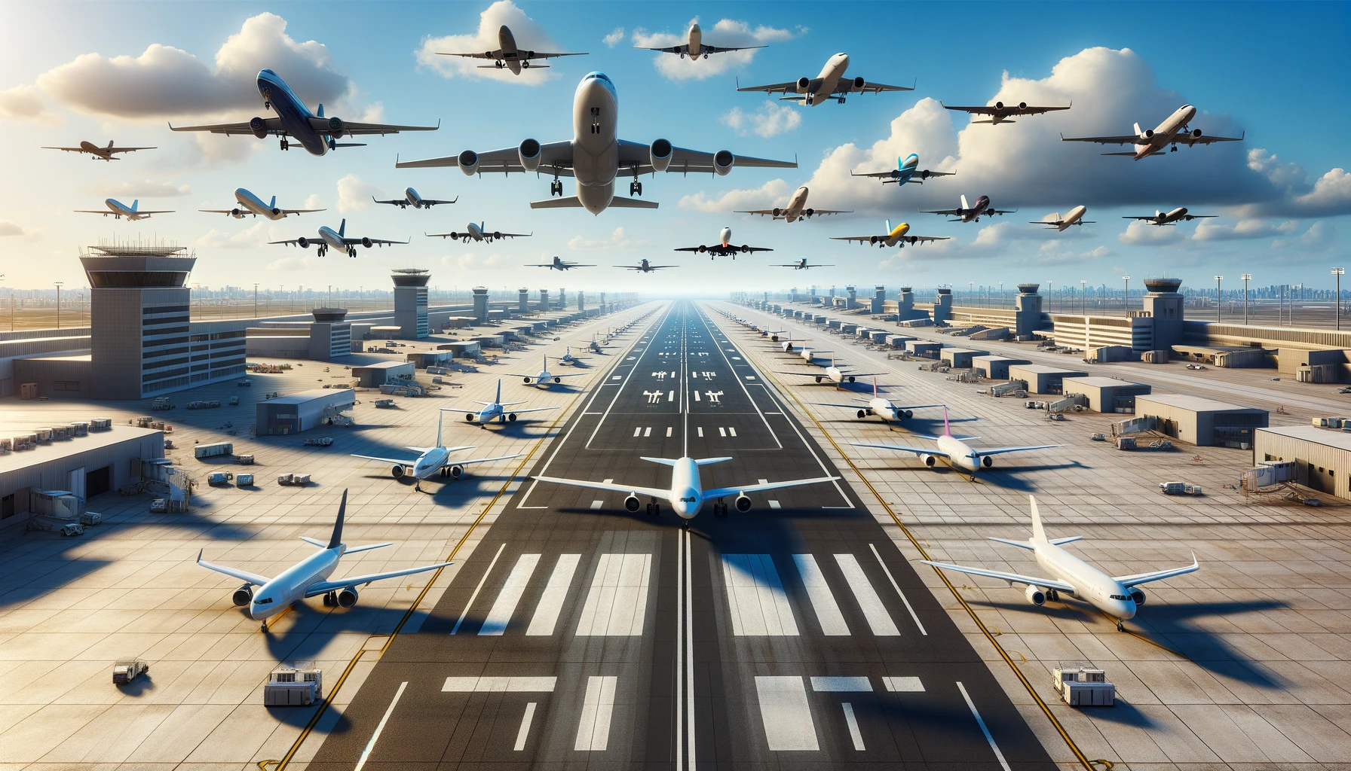
Challenges
SAFETY FLIGHT
Presentations are tools that can be used as lectures, speeches, reports, and more. It is mostly presented like before an audience.
FAST FLIGHT
Presentations are tools that can be used as lectures, speeches, reports, and more. It is mostly presented like before an audience.

Slide 20
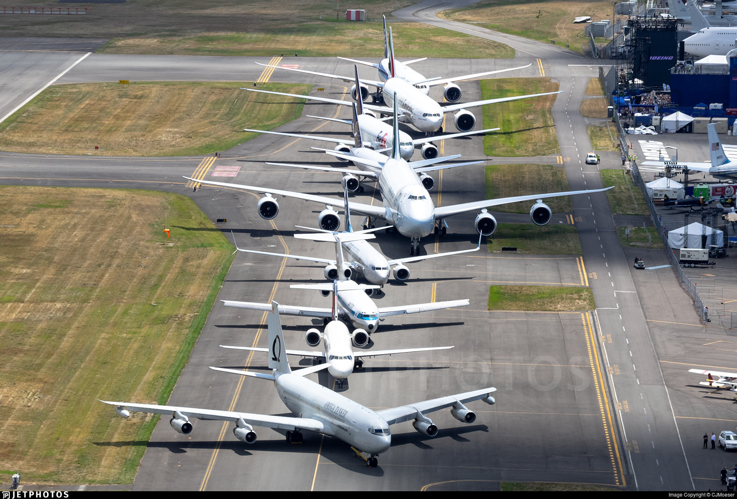

Conclusion
PRIVATE JET PRESENTATION
Presentations are tools that can be used as lectures, speeches, reports, and more. It is mostly presented are tools that can tools that can be used.
Start Slide

Slide 21
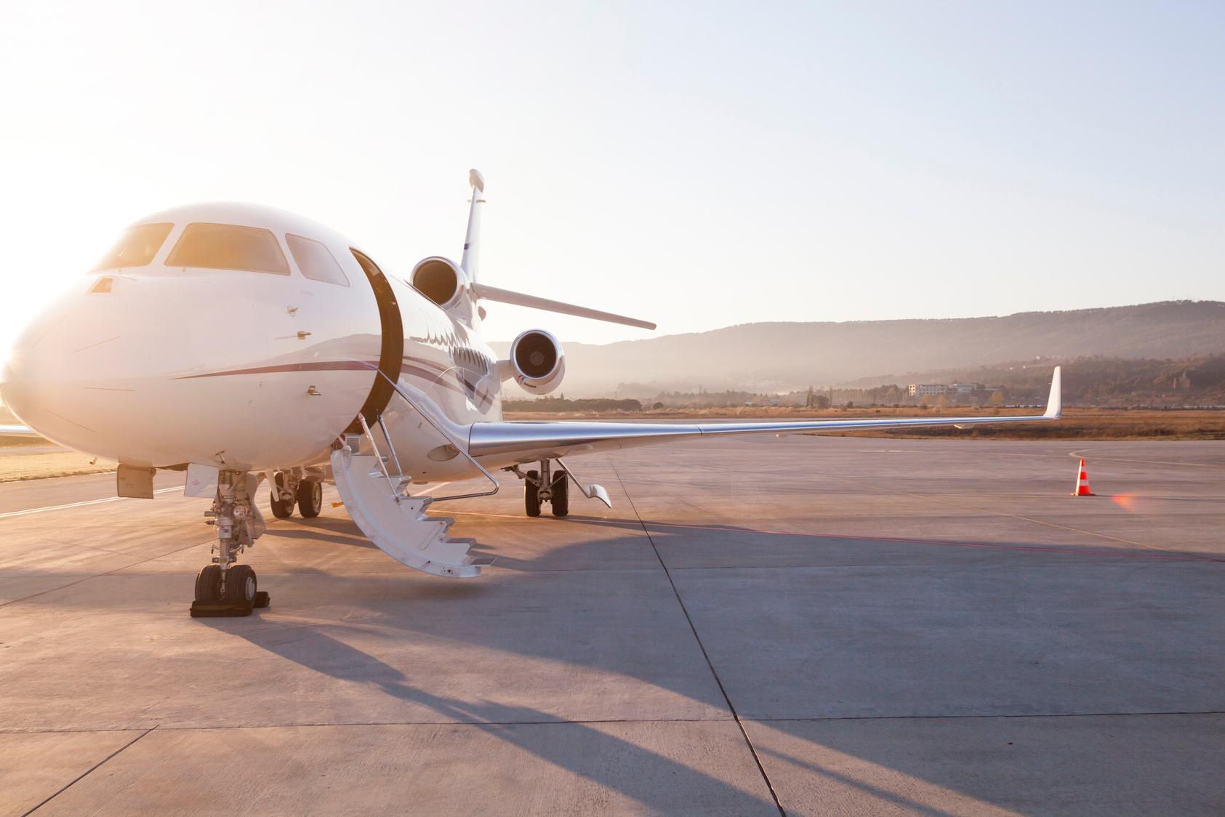
THANK YOU

Slide 22
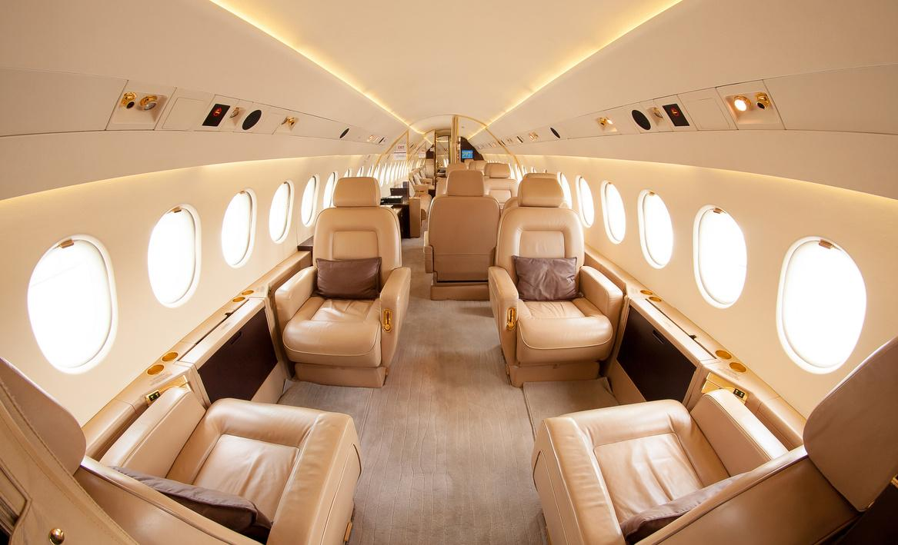
Content
Slides structure (12 mins):
Lila-
Title: Unveiling Flight Disruptions Insights
Content and business motivation
Data source and data overview
Kelly-
Location aspect
Airline aspect (1/2)
Mitchell
Airline aspect (2/2)
Time aspect
Senha-
ML process & results
Tanvi-
Conclusion
Challenges (& suggestions for further study)

Slide 23
Things to include while mentioning graphs:
All cities except Dallas have regional airports, which is not surprising that they have delays
In graph 7, only skywest is a regional airline, rest all are international
Whoever talks about time graphs (graph 9) should also mention that there is no distinguishable patterns by day of the week and by weekday/weekend
We see a jump in cancellations by month, which is why we dive deeper into understanding why that is. Turns out it is because of COVID. (heatmap)

Slide 24



Private Jet
PRIVATE JET RENTAL
PRIVATE JET COMPANY PROFILE
Presentations are tools that can be used as lectures, speeches, reports, and more. It is mostly presented
Start Slide
PAGE 1/10

Slide 25
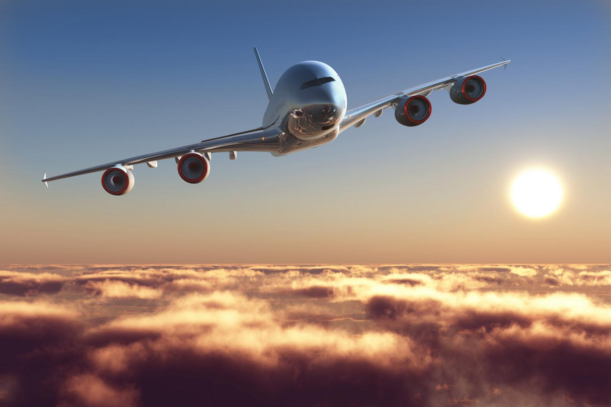
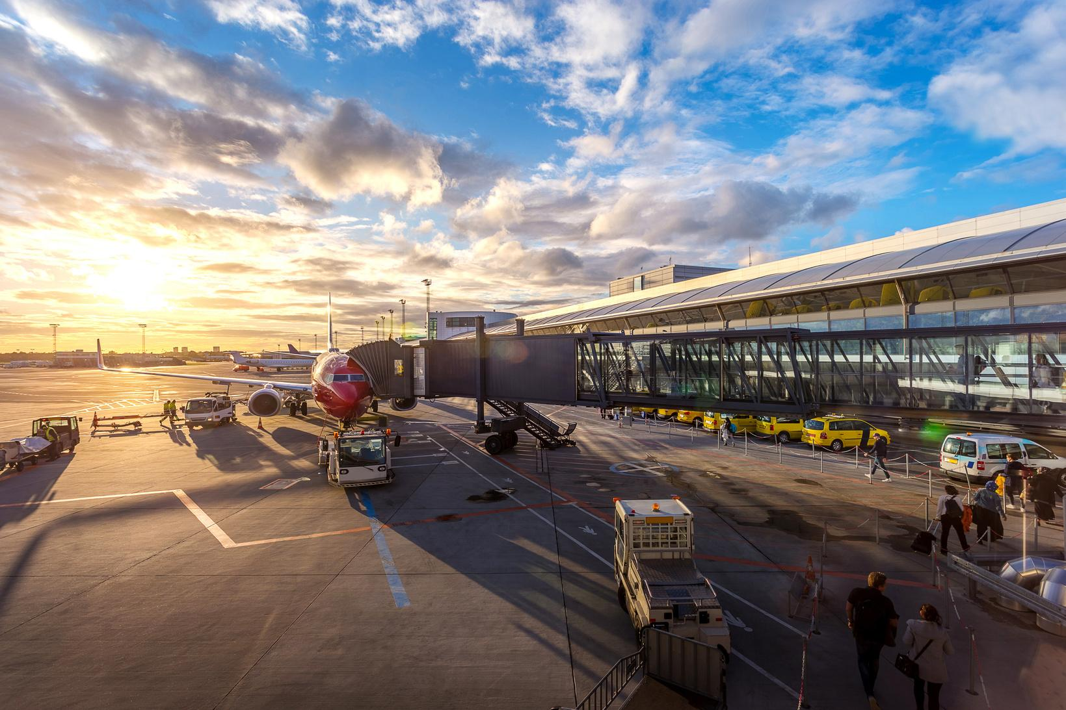
INNOVATION SERVICE
Location
Airline
Time
PAGE 7/10

Slide 26
Private Jet
ABOUT OUR COMPANY
Presentations are tools that can be used as lectures, speeches, reports, and more. It is mostly presented like before an audience.
ABOUT US
SINCE 1989
Presentations are tools that can be used as lectures, speeches, reports
Presentations are tools that can be used as lectures, speeches, reports
PAGE 2/10

Slide 27


Private Jet
PRIVATE
BUSINESS TRIP
Presentations are tools that can be used as lectures, speeches, reports, and more. It is mostly presented
BUSINESS TRIP SERVICE
Description Here
www.reallygreatsite.com
PAGE 3/10

Slide 28
FLIGHT EVERYWHERE
Presentations are tools that can be used as lectures, speeches, reports, and more. It is mostly presented like before an audience.
FLIGHT AS YOU GO
Presentations are tools that can be used as lectures, speeches,

Slide 29
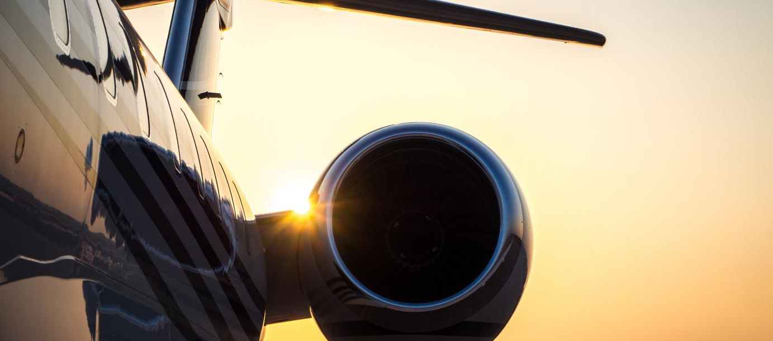
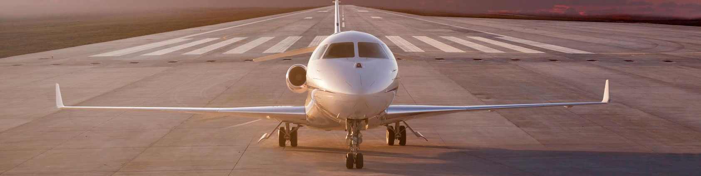
Private Jet
PRIVATE JET SPECIFICATION
Presentations are tools that can be used as lectures, speeches, reports, and more. It is mostly presented like before an audience.
LUXURY SERVICE
SAFETY SECURITY
COMFORT JET
FASTER MACHINE
www.reallygreatsite.com
PAGE 5/10

Slide 30

Private Jet
BOOKING
OUR PLANE
Presentations are tools that can be used as lectures, speeches, reports, and more. It is mostly presented
1.234K
70 % - 92%
Presentations are tools that can be used as lectures, speeches.
Presentations are tools that can be used as lectures, speeches.
www.reallygreatsite.com
PAGE 8/10

Slide 31
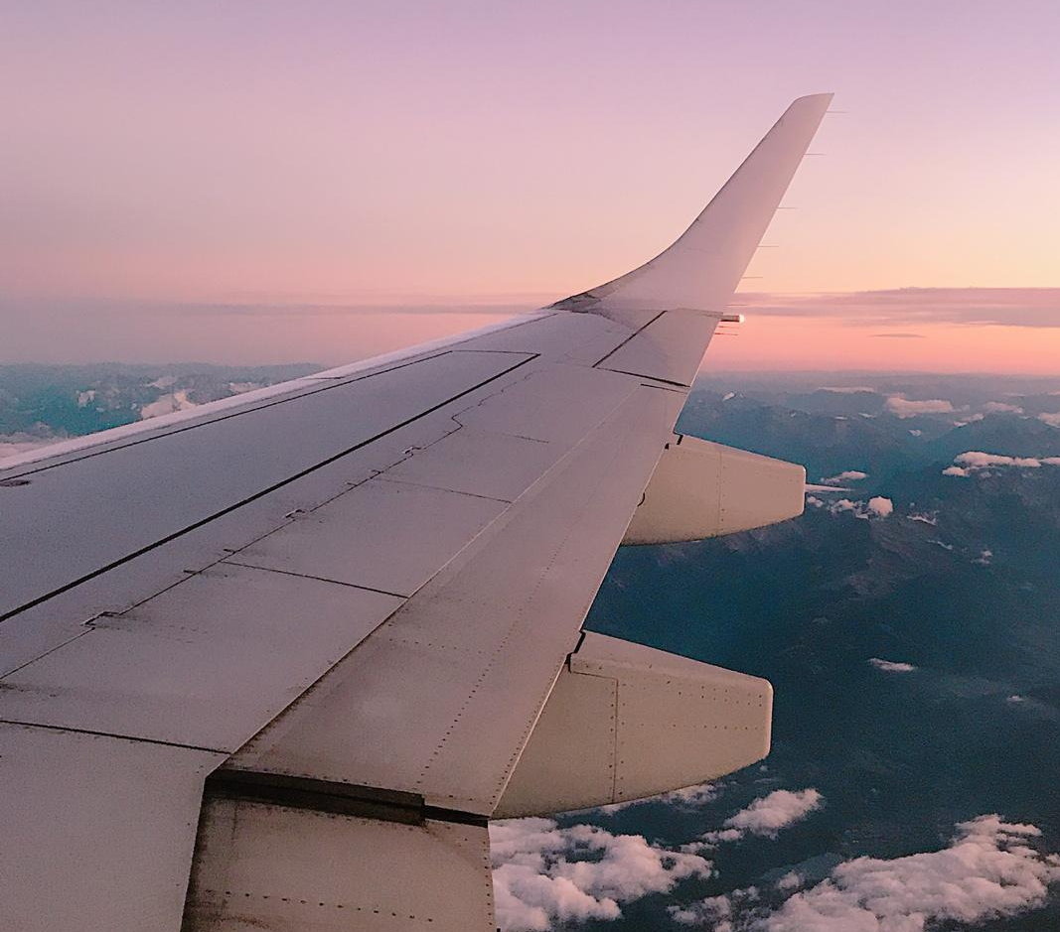
Private Jet
Challenges
Presentations are tools that can be used as lectures, speeches, reports, and more. It is mostly presented like before an audience.
FAST FLIGHT
SAFETY FLIGHT
www.reallygreatsite.com
PAGE 9/10

